Slide 1
Summary of our daily Rec Games
Day 1 : Tender Loving Guidance.
Day 2 : 4Give Buckets.
Day 3 : BEANing Worthy.
Day 4 : Levitation Ball
Day 5 : Tower of Life.

Slide 2
Day 2 Rec Game
4Give Buckets!

Slide 3
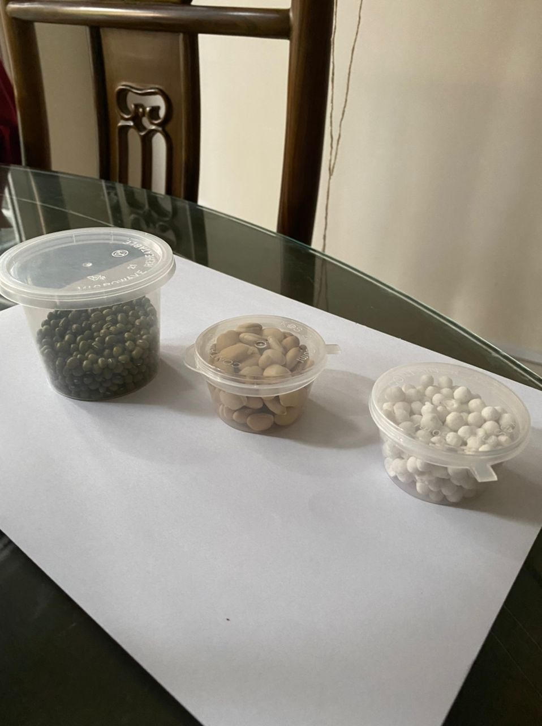
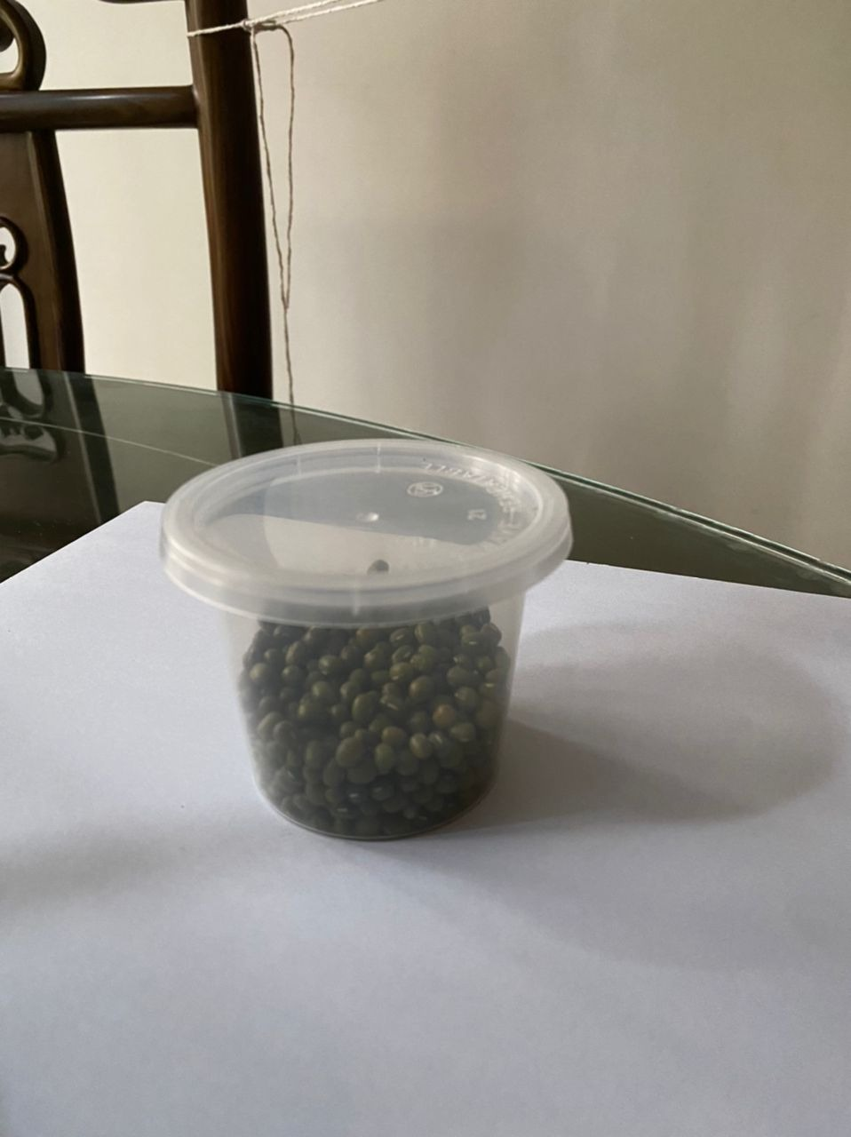
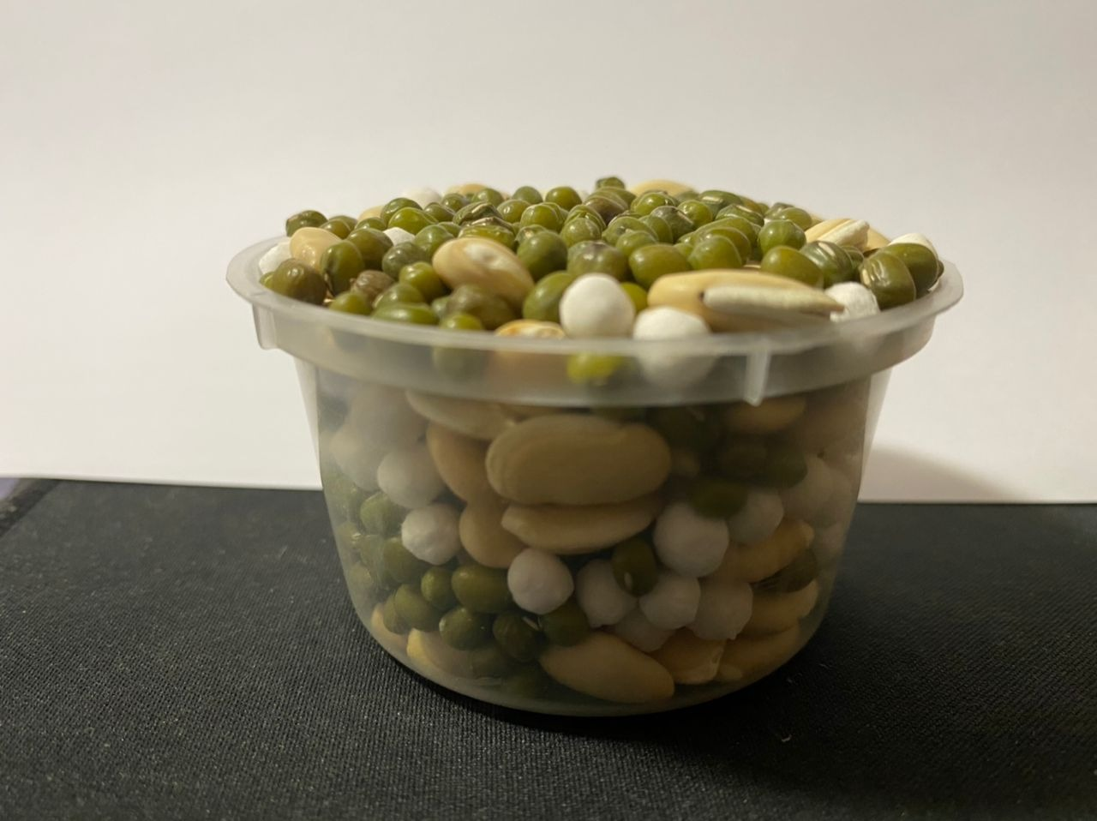
Step 1
Step 2
Step 3
2
For Pre School, Std 1 & 2 Children
Pls setup your props such that your camera can view you playing the game during the Zoom session.
ALL the seed must fit into the container, No over filling above the lid.
Take out the 3 containers from your Rec package.
Try & fill all 3 types of seeds into the big container.

