Slide 1
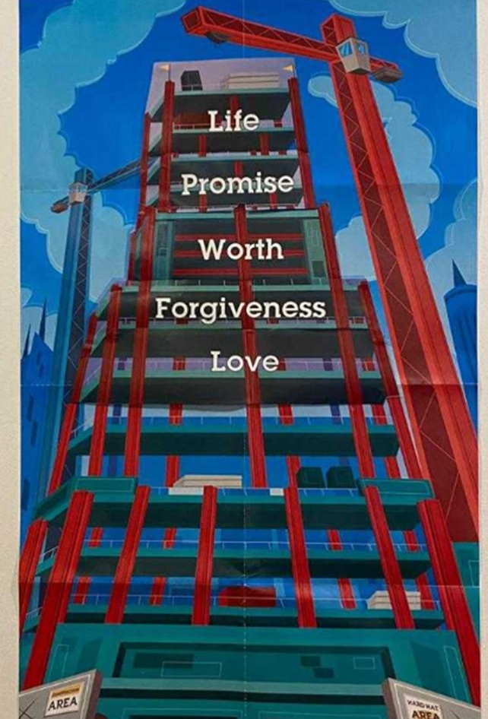
Summary of our daily Rec Games
Day 1 : Tender Loving Guidance.
Day 2 : 4Give Buckets.
Day 3 : BEANing Worthy.
Day 4 : Levitation Ball
Day 5 : Tower of Life.

Slide 2
Day 3 Rec Game
Beaning Worthy!

Slide 3
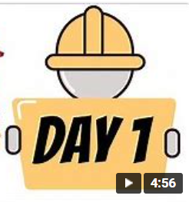
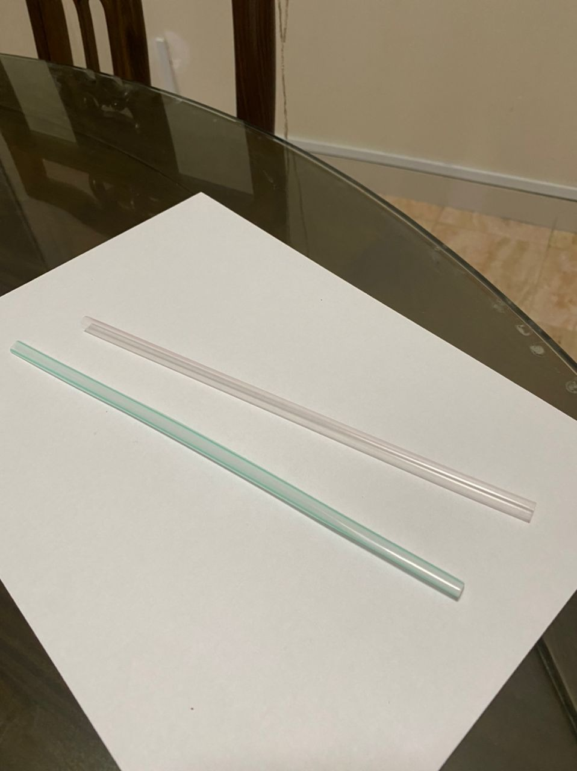
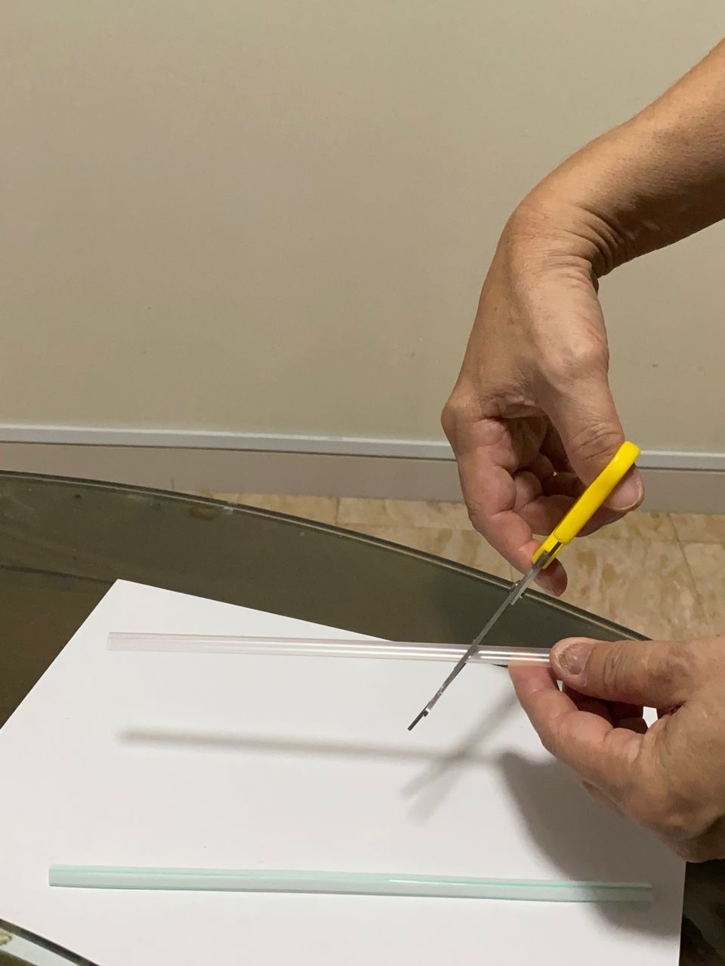
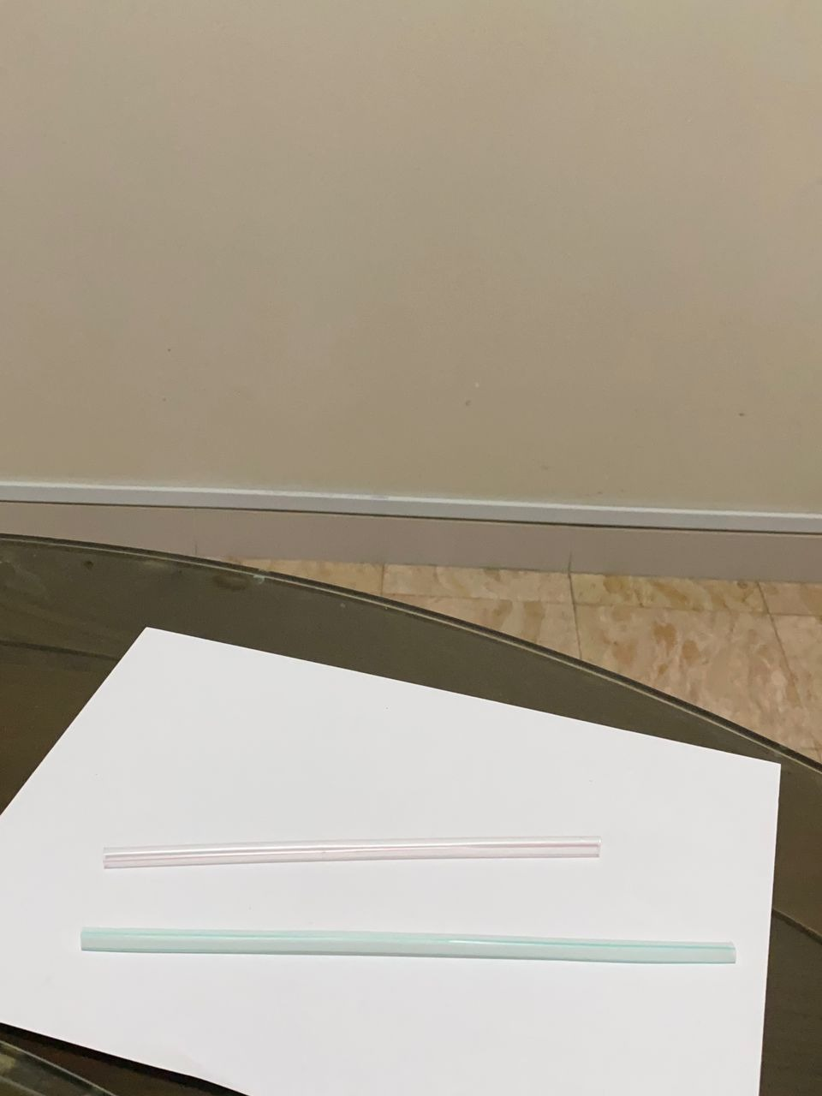
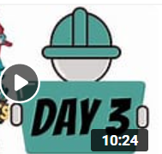
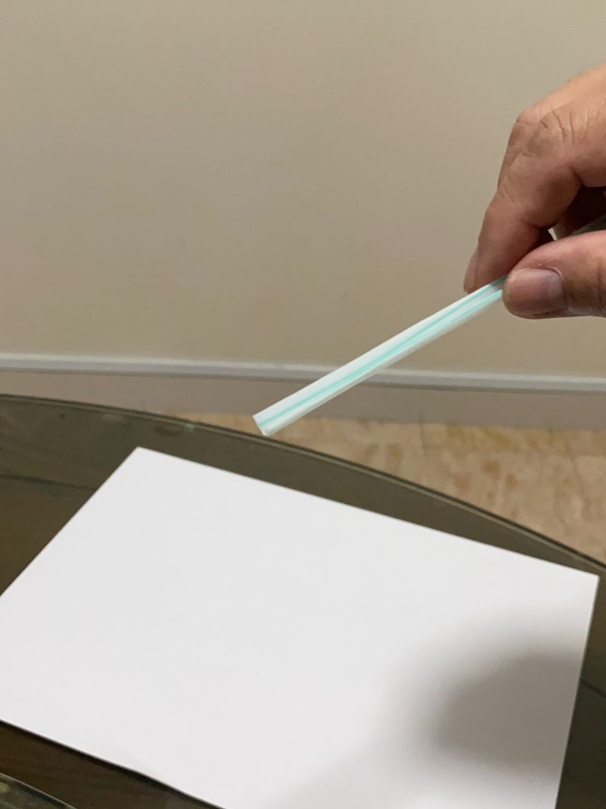
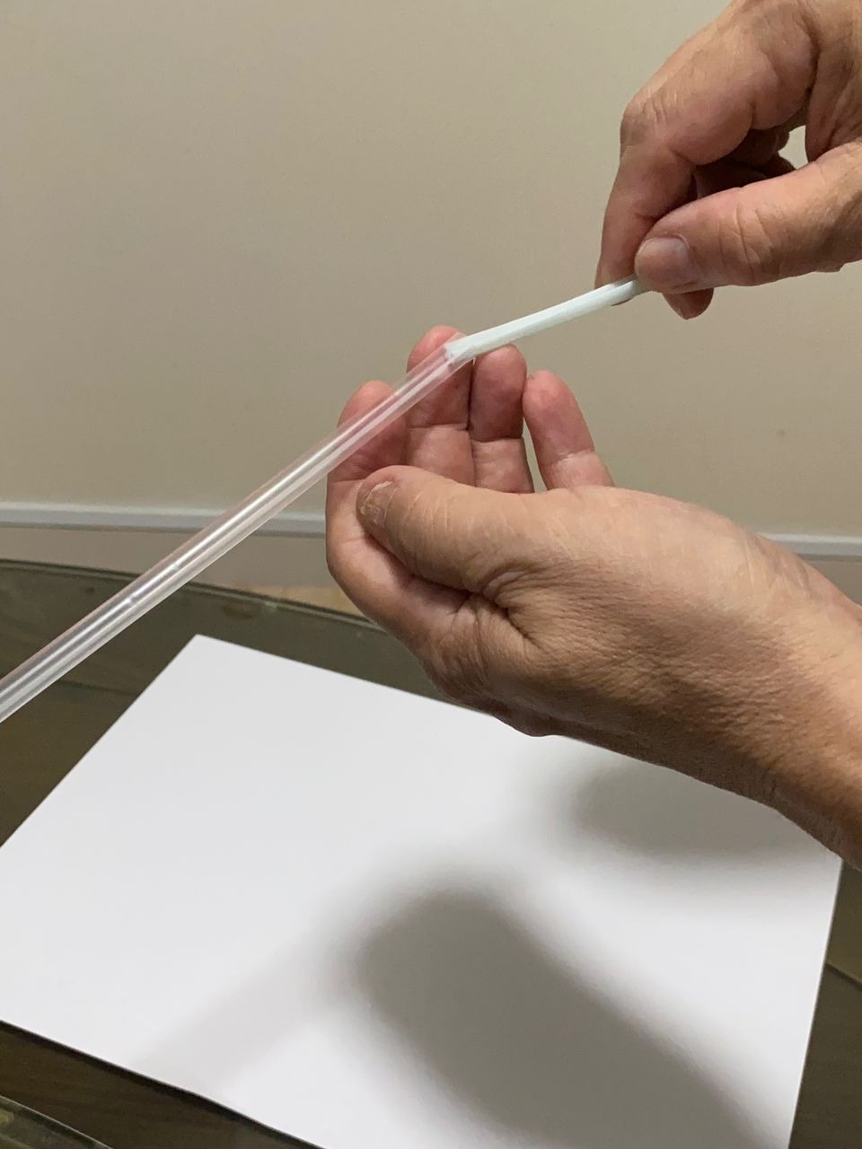
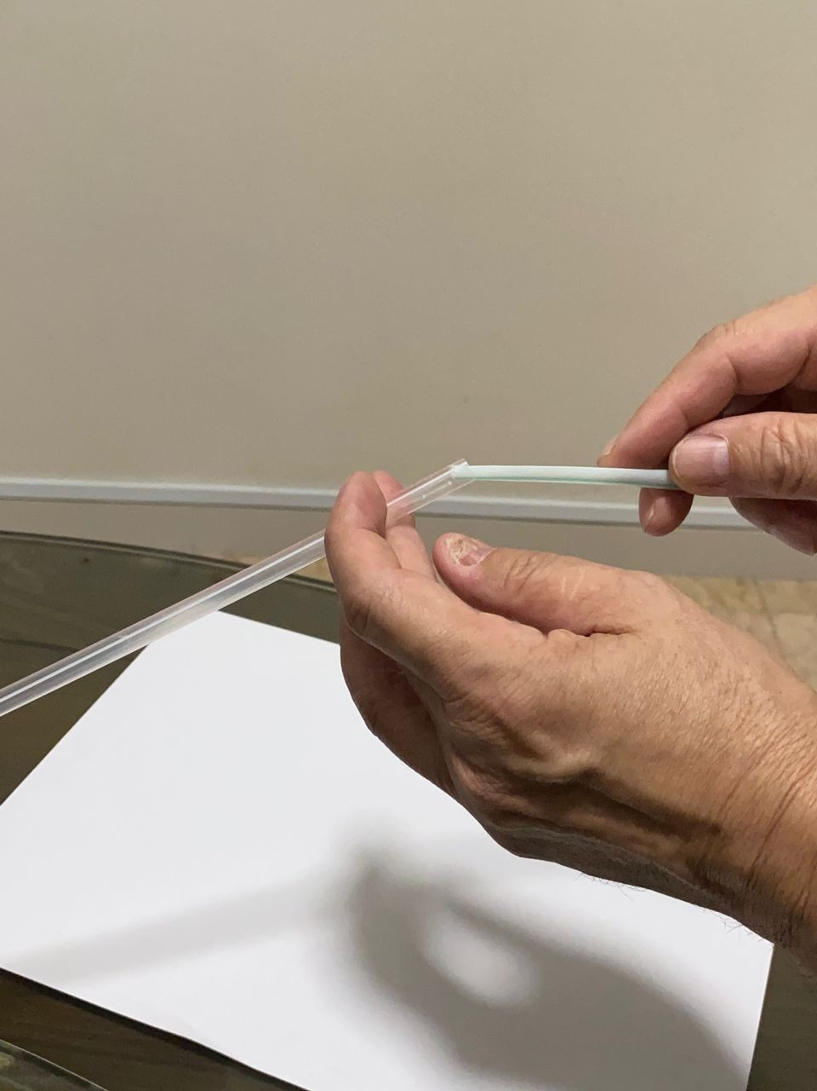
Use the 2 straws from the Rec package.
Cut one straw shorter by 2 inches.
The two straws as shown.
3
For Pre School, Std 1 & 2 Children
Pls ask for help from parents, siblings, to set up the props for the game.
Pls setup your props such that your camera can view you playing the game during the Zoom session.
Step 1
Step 2
Step 3
Fold one straw into half as shown so that it is narrower.
Fit the folded straw into the 2nd straw.
The inner straw will act as a pusher.
Step 4
Step 5
Step 6

Slide 4
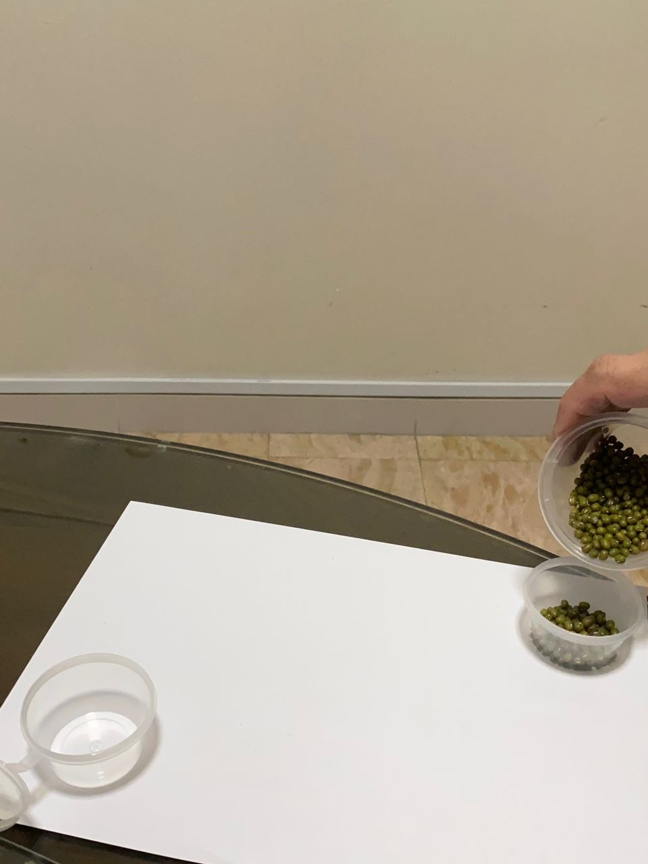
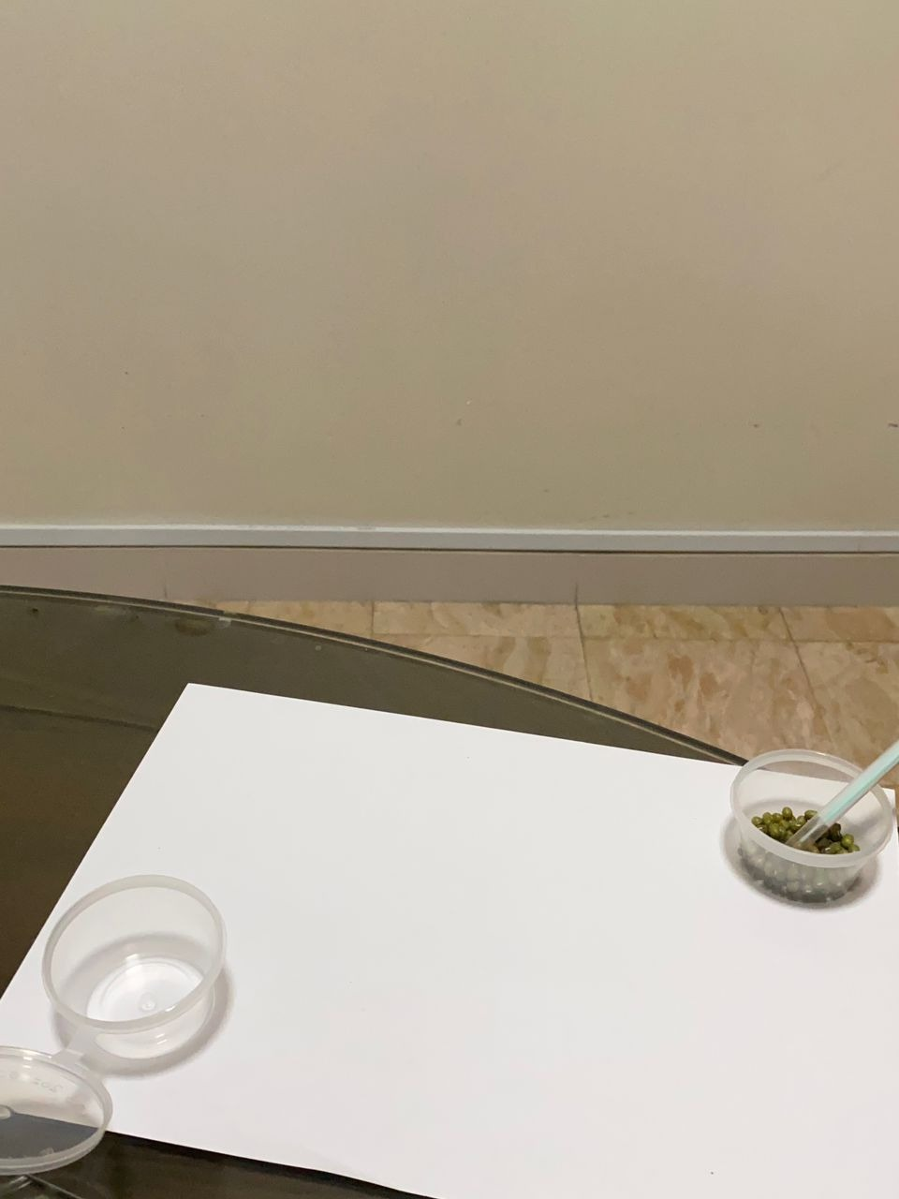
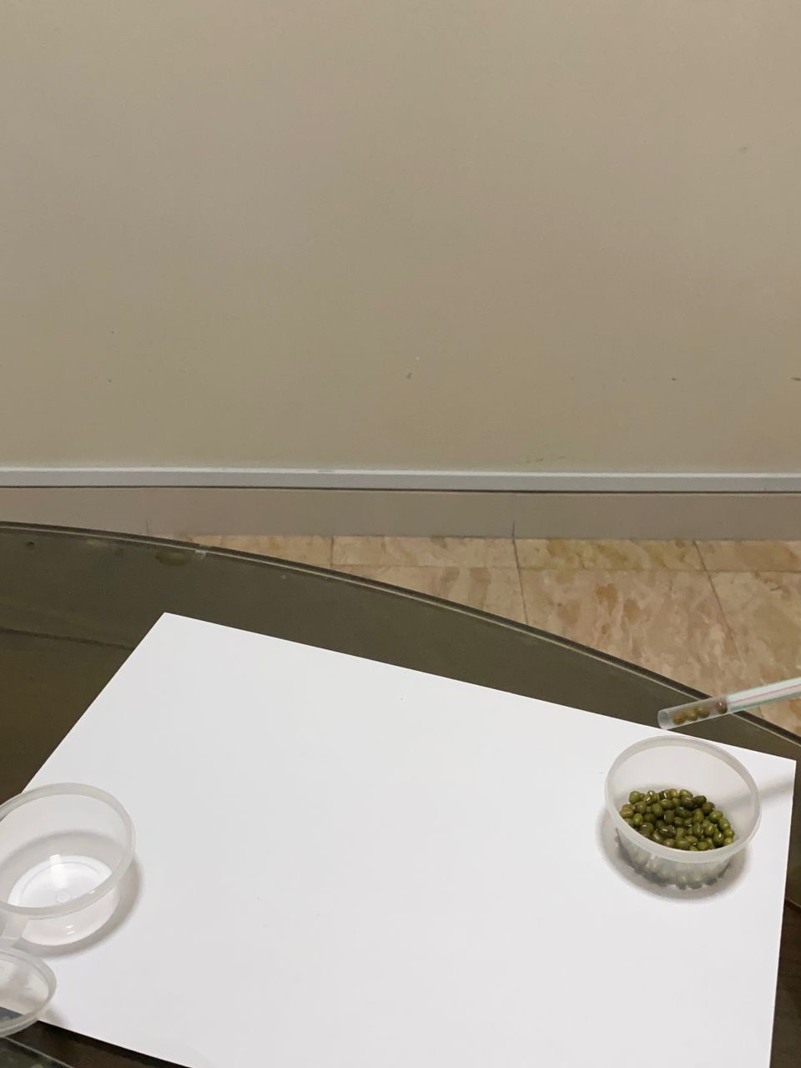
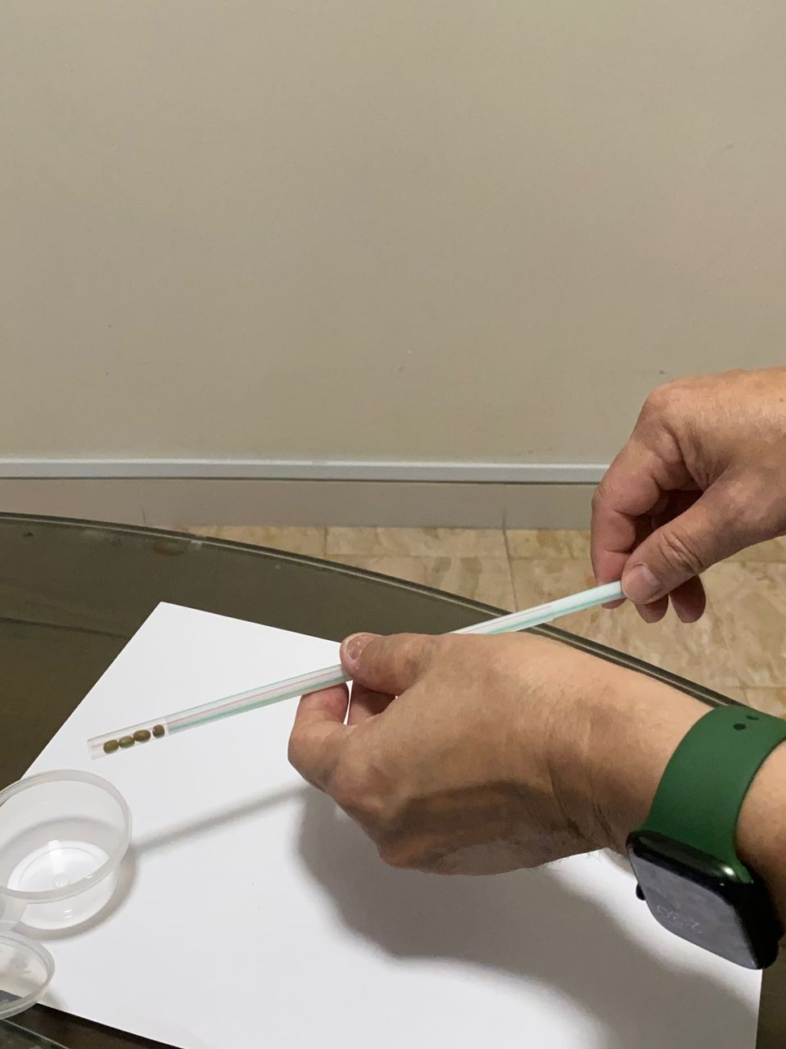
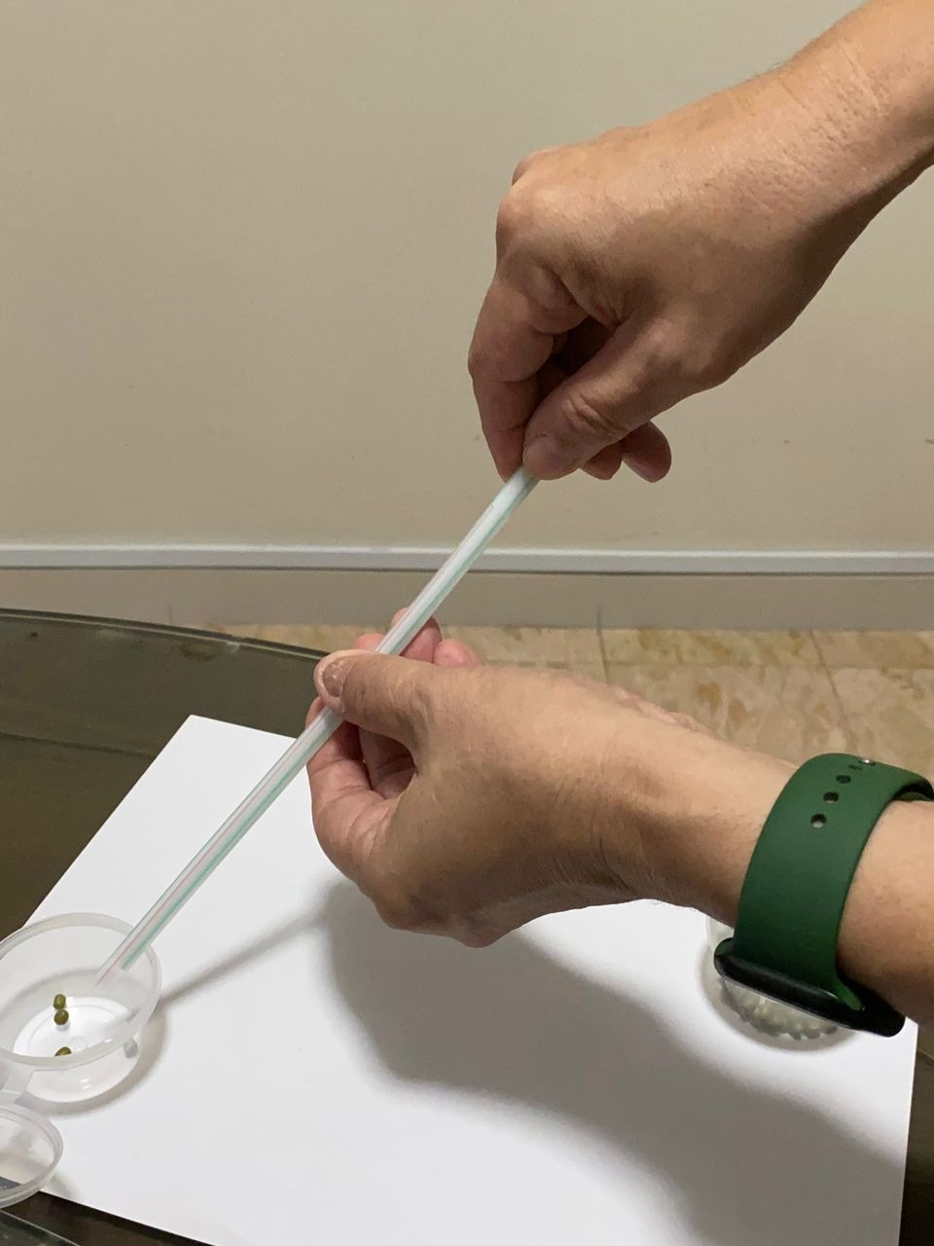
Place 2 containers at opposite ends of the paper. Pour the green beans into one container.
Use the two straw prop use made to scoop up the beans.
Without touching the beans with your hands, only using the straws, transfer the beans to the other container at opposite end.
3
For Pre School, Std 1 & 2 Children
Step 7
Step 8
Step 9
Transfer an many beans as you can to the other container.
Only beans dropped in the contain will be counted.
Step 10
Step 11

Slide 6
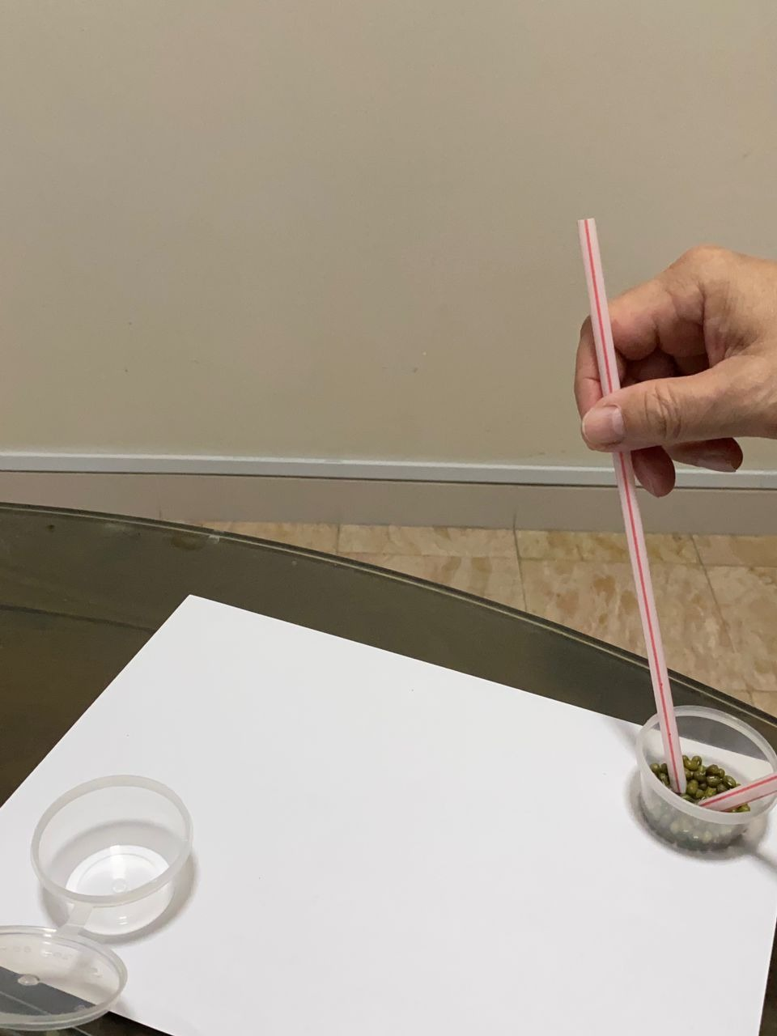
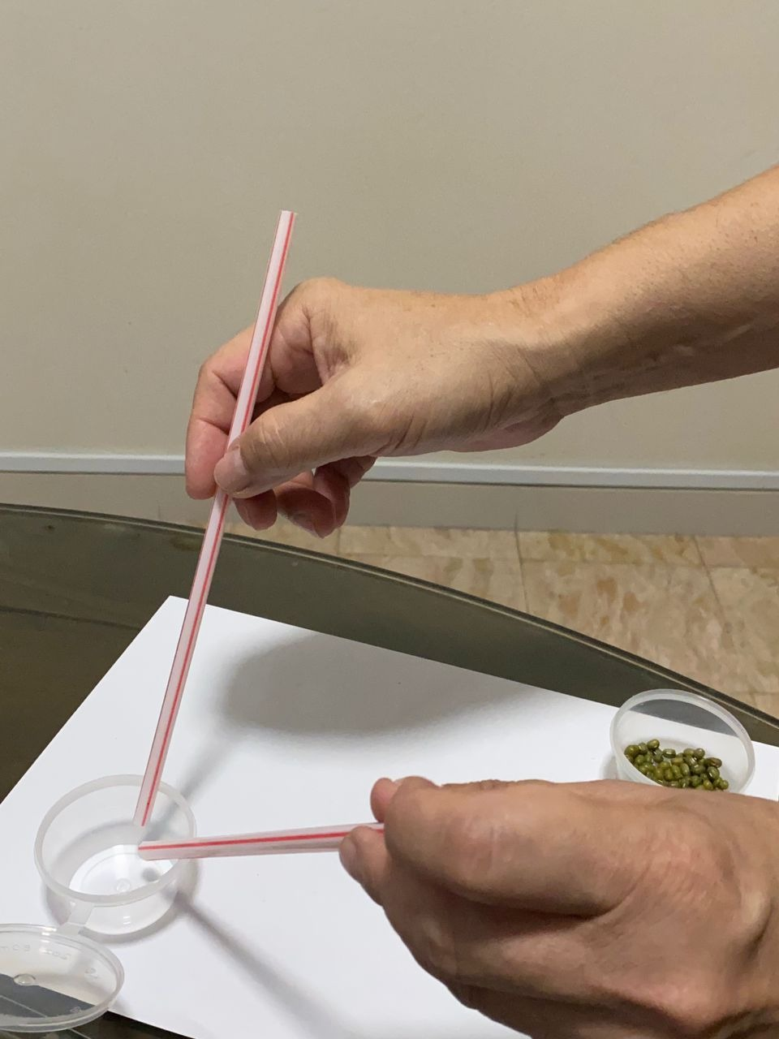
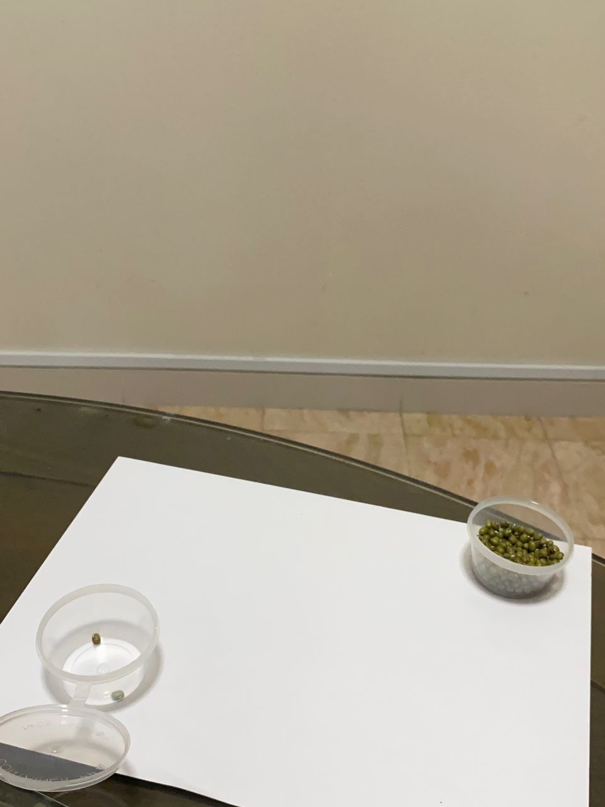
Place 2 containers at opposite ends of the paper.
Use only two straws, pick up the green beans as shown.
Transfer the beans inside the straws and drop them to the opposite container.
3
For Std 3-4 & Preteens.
If necessary pls ask for help from parents, siblings, to set up the props for the game.
Pls setup your props such that your camera can view you playing the game during the Zoom session.
Step 1
Step 2
Step 3
Only beans dropped off into the container will be counted.
Step 4

