Slide 1
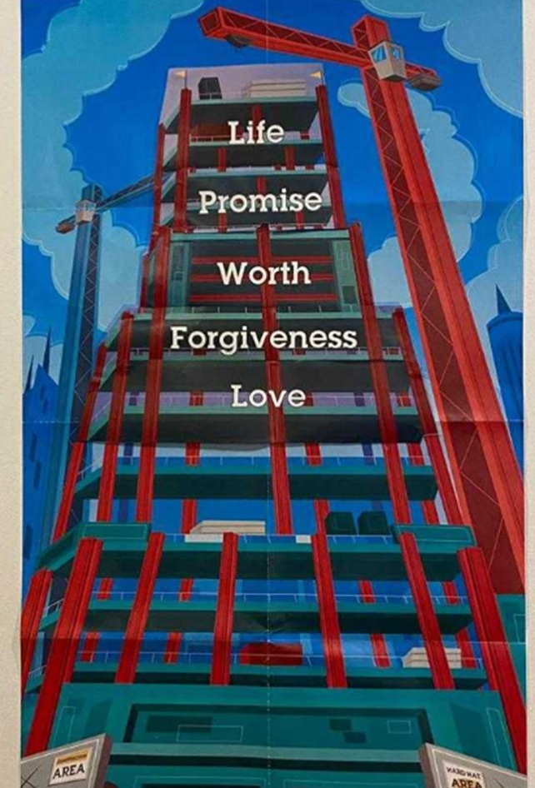
Summary of our daily Rec Games
Day 1 : Tender Loving Guidance.
Day 2 : 4Give Buckets.
Day 3 : BEANing Worthy.
Day 4 : Levitation Ball
Day 5 : Tower of Life.

Slide 2
Day 4 Rec Game
Levitation Ball!

Slide 3
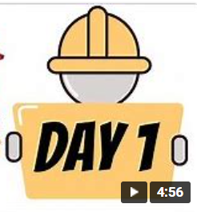
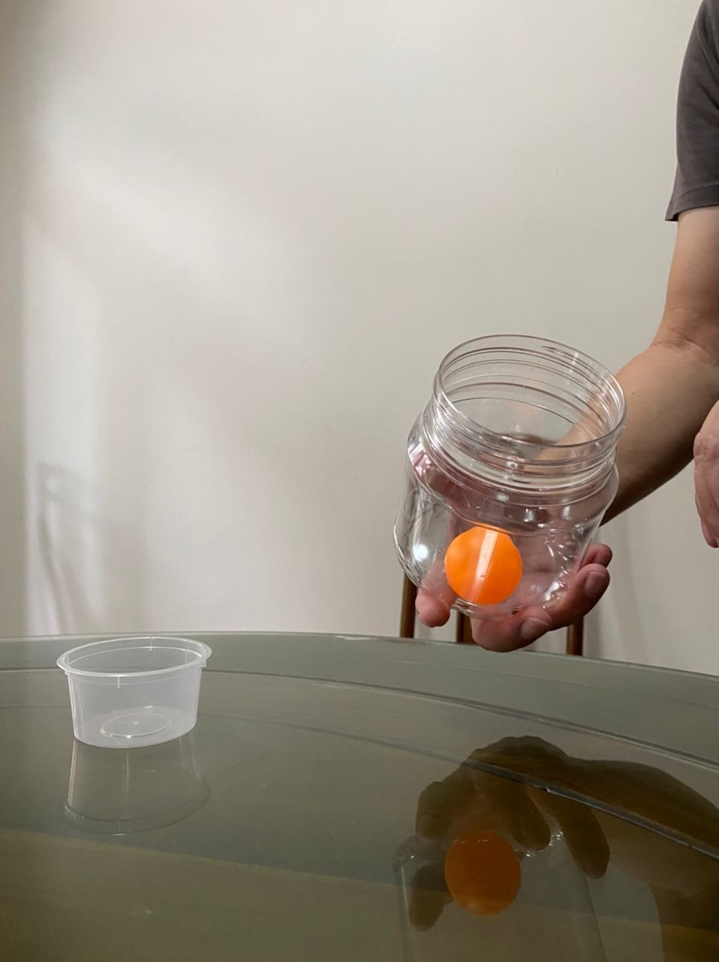
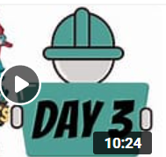
Place open small container on the table.
Place the ping pong into the big container as shown.
Spin the container with the ping pong inside and transfer it into the small container as shown.
The two straws as shown.
4
For Pre School, Std 1 & 2 Children
Pls ask for help from parents, siblings, to set up the props for the game.
Pls setup your props such that your camera can view you playing the game during the Zoom session.
Step 1
Step 2
Step 3

Slide 4
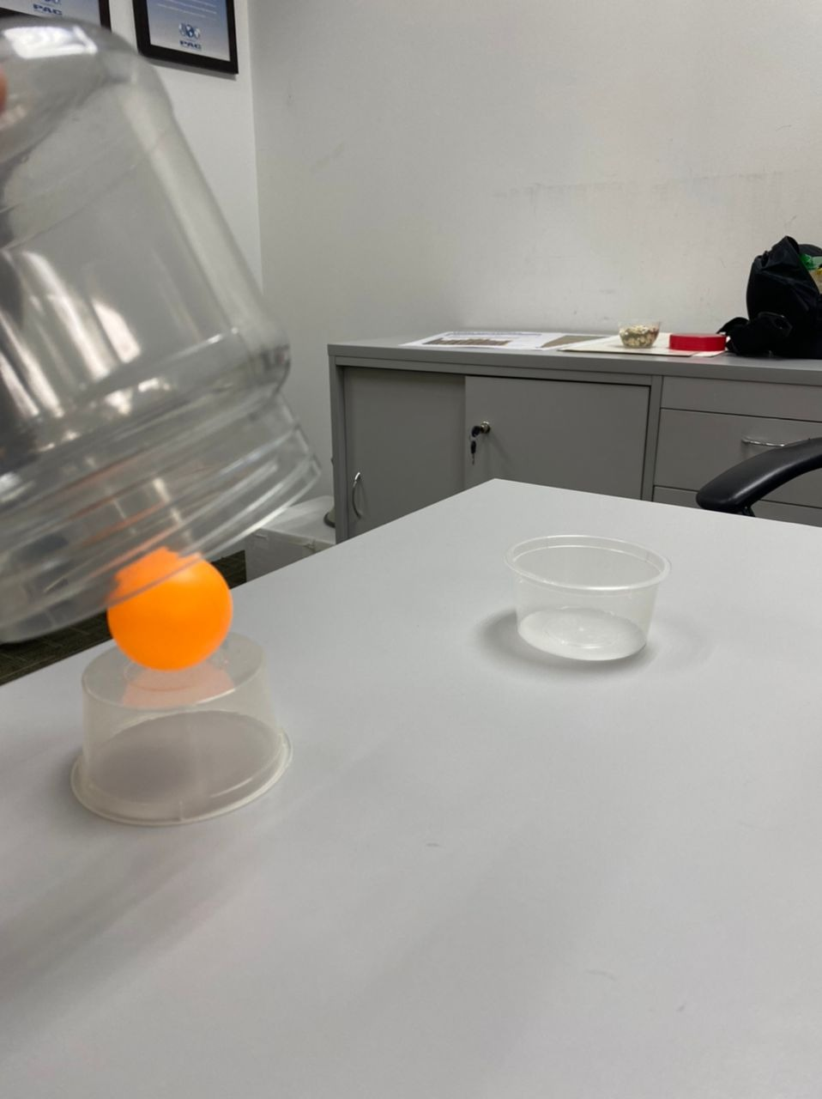
Place ping pong on small container on the table.
Spin the container with the ping pong inside and transfer it into the small container as shown.
4
For Pre School, Std 1 & 2 Children
Pls ask for help from parents, siblings, to set up the props for the game.
Pls setup your props such that your camera can view you playing the game during the Zoom session.
Step 1
Step 2

